Slide 1
Railway Reservation
Technology used :
Java Language
netbeans IDE
Oracle database 10g tech

Slide 2
objective
Our project introduces railway reservation system with an objective to make the reservation system more efficient, easier and fast. This project explores how computer technology can be used to solve the problem of user. The main objectives provided by this software are as follows:

We can enquire about availability of trains

We can reserve and cancel their seats

We can modify the information related to
a)Trains
1)Timetable
2)Train Name
3)Train Number
b) Ticket Fare

Slide 3
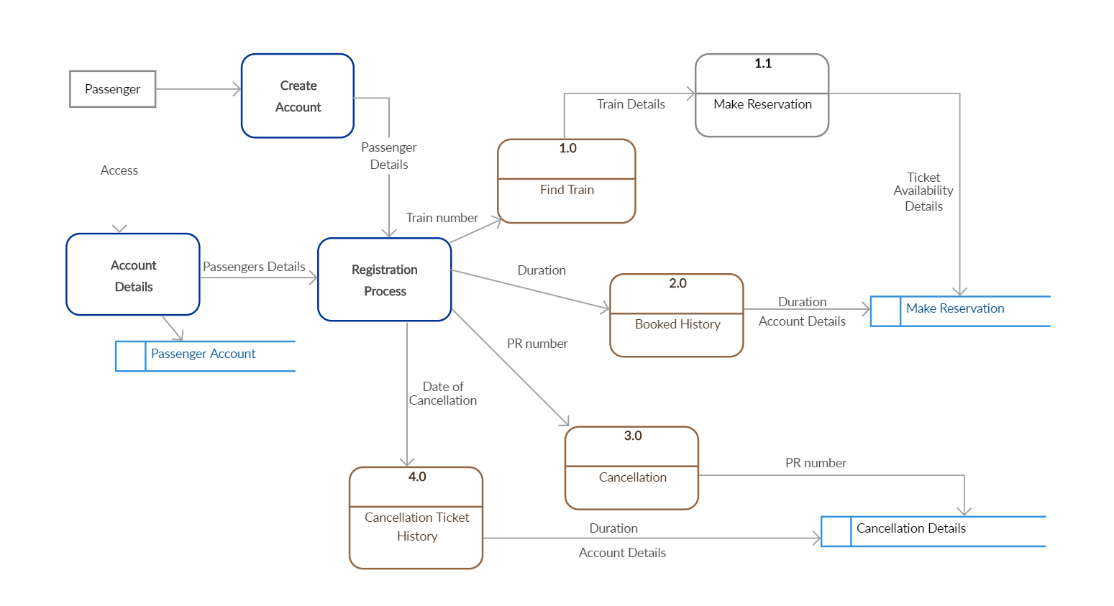
Data flow diagram

Slide 4
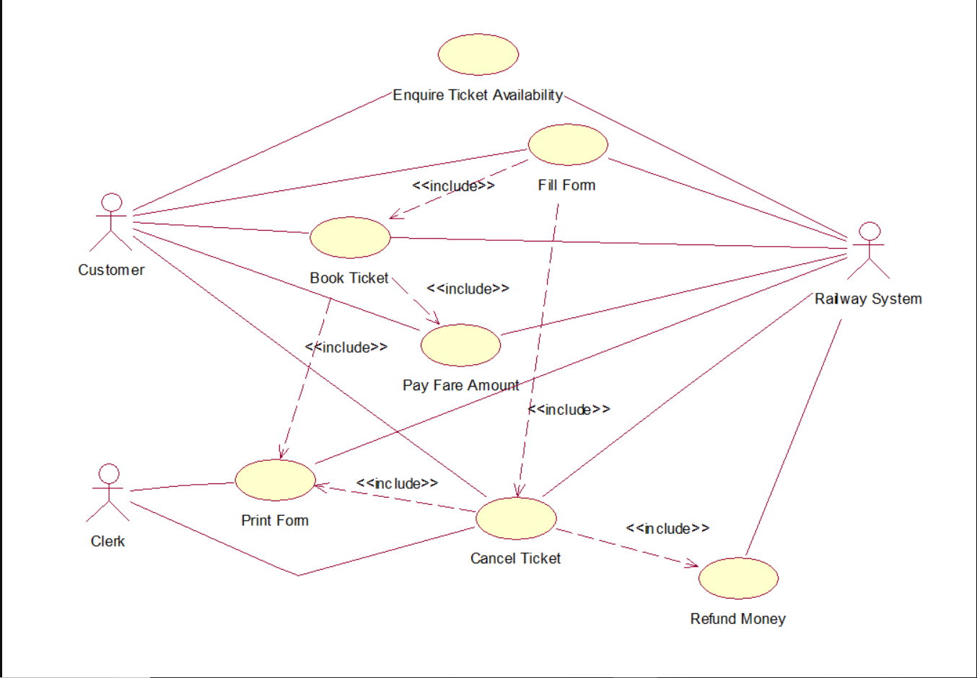
Use case diagram

Slide 5
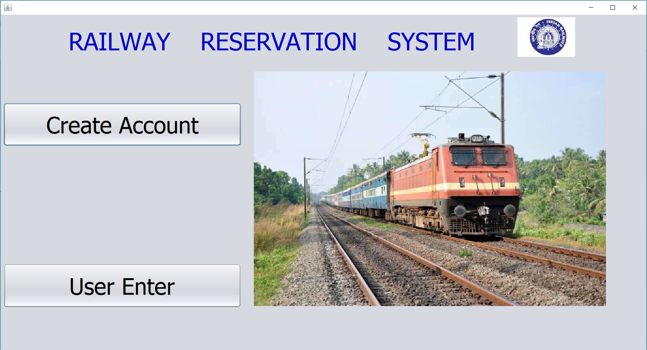

Slide 6
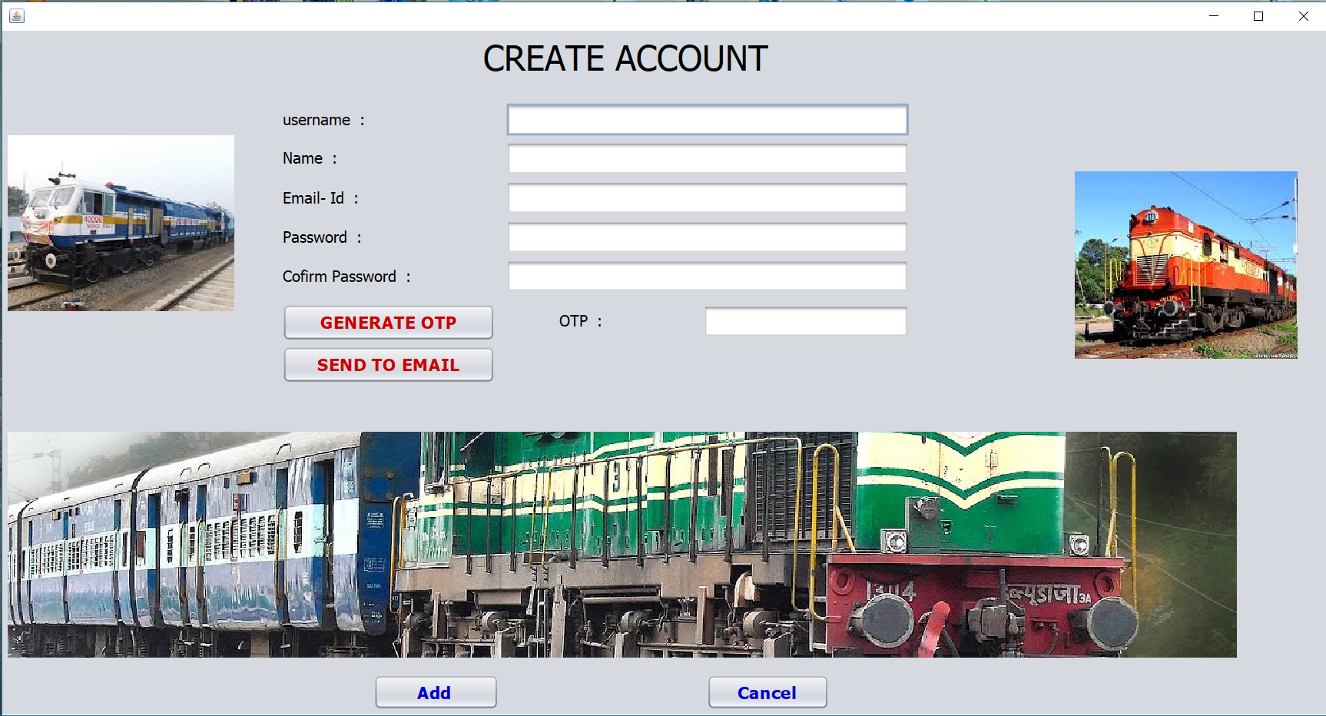

Slide 7
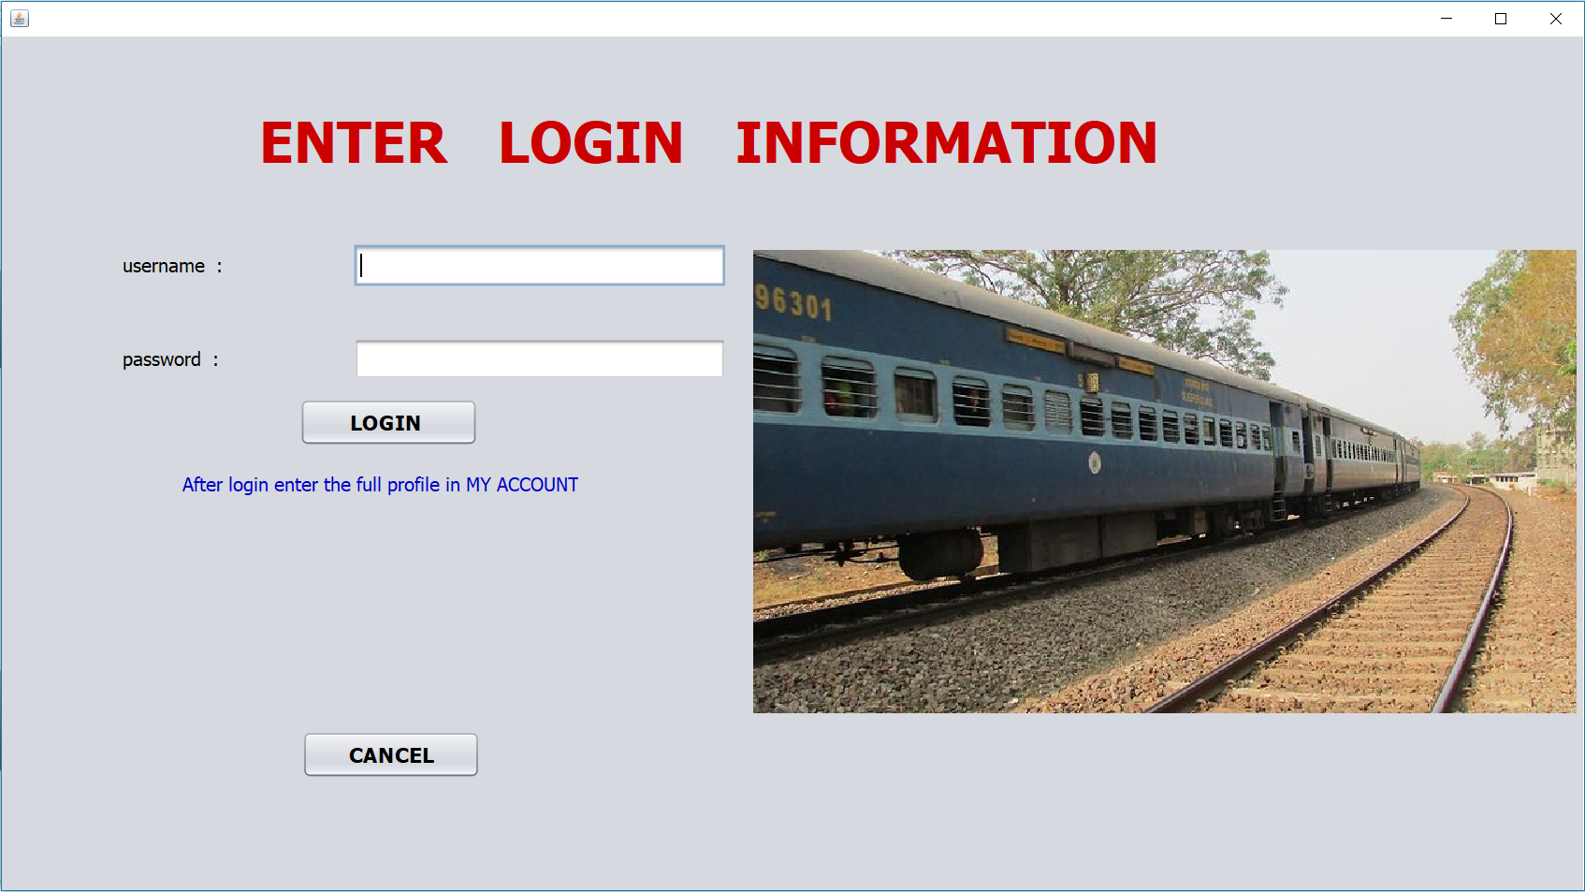

Slide 8
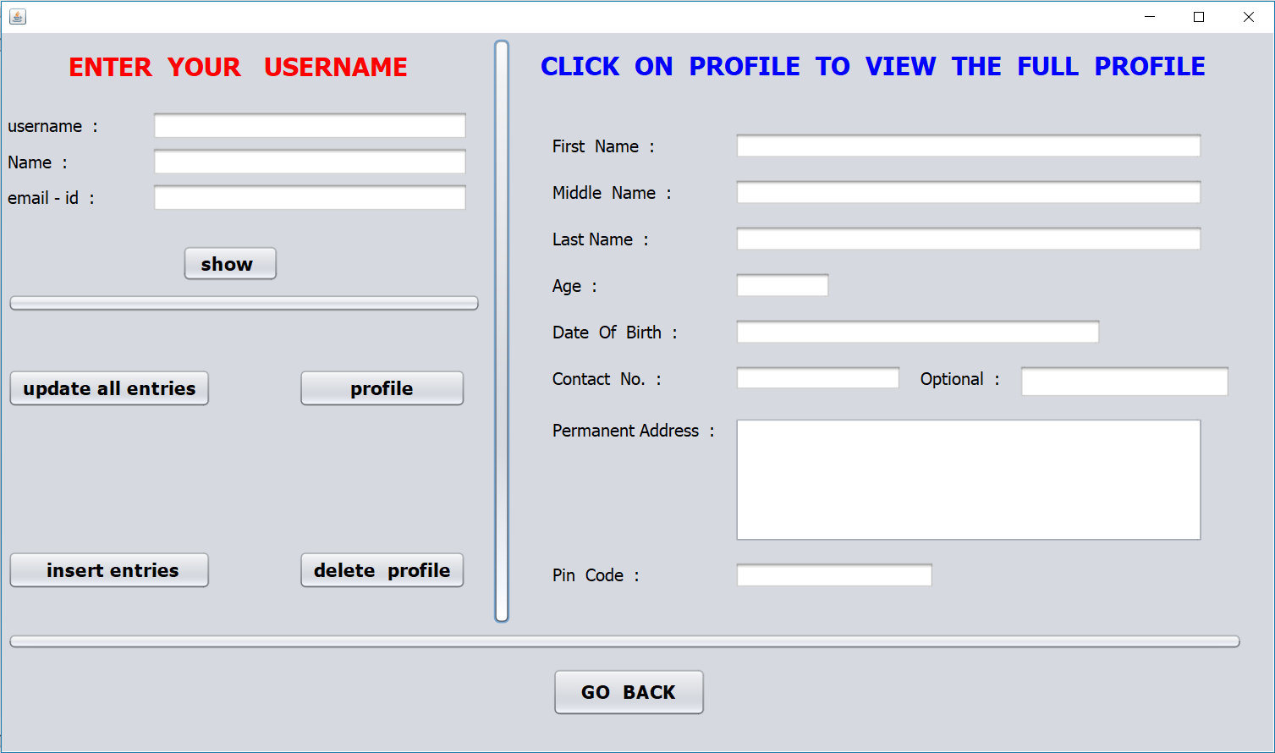

Slide 9
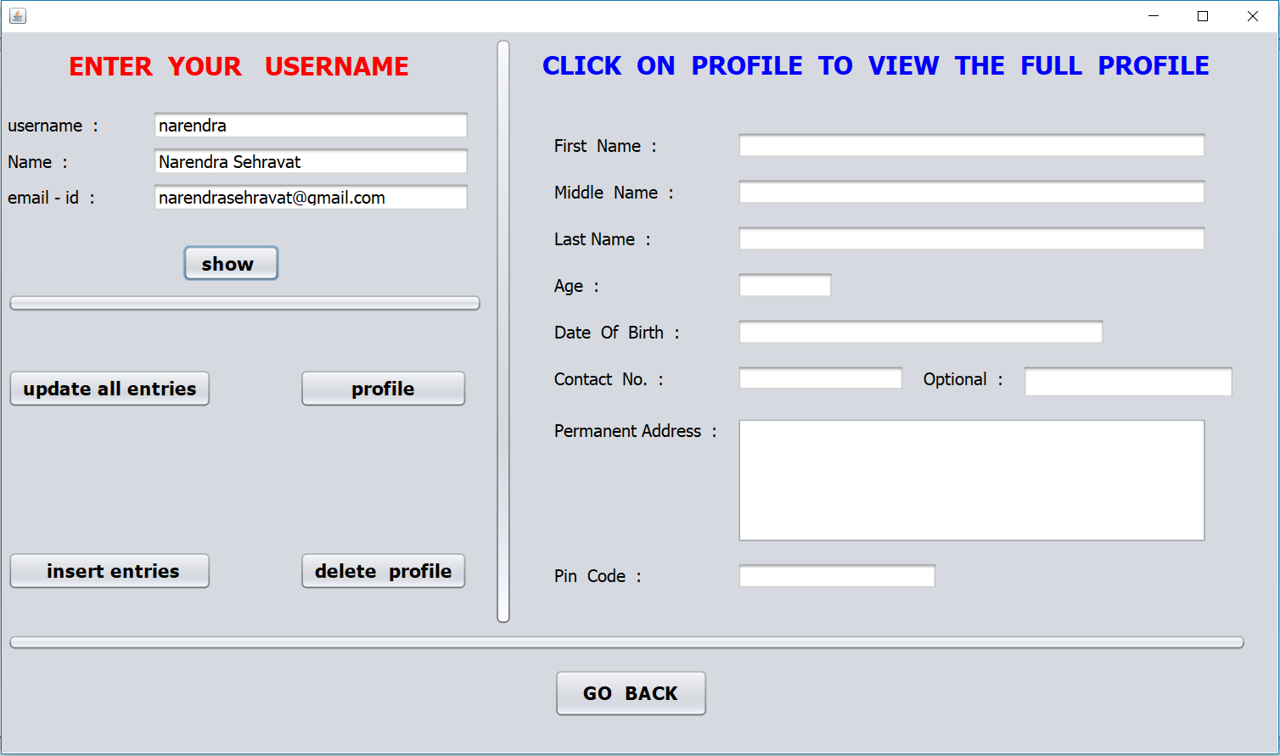

Slide 10
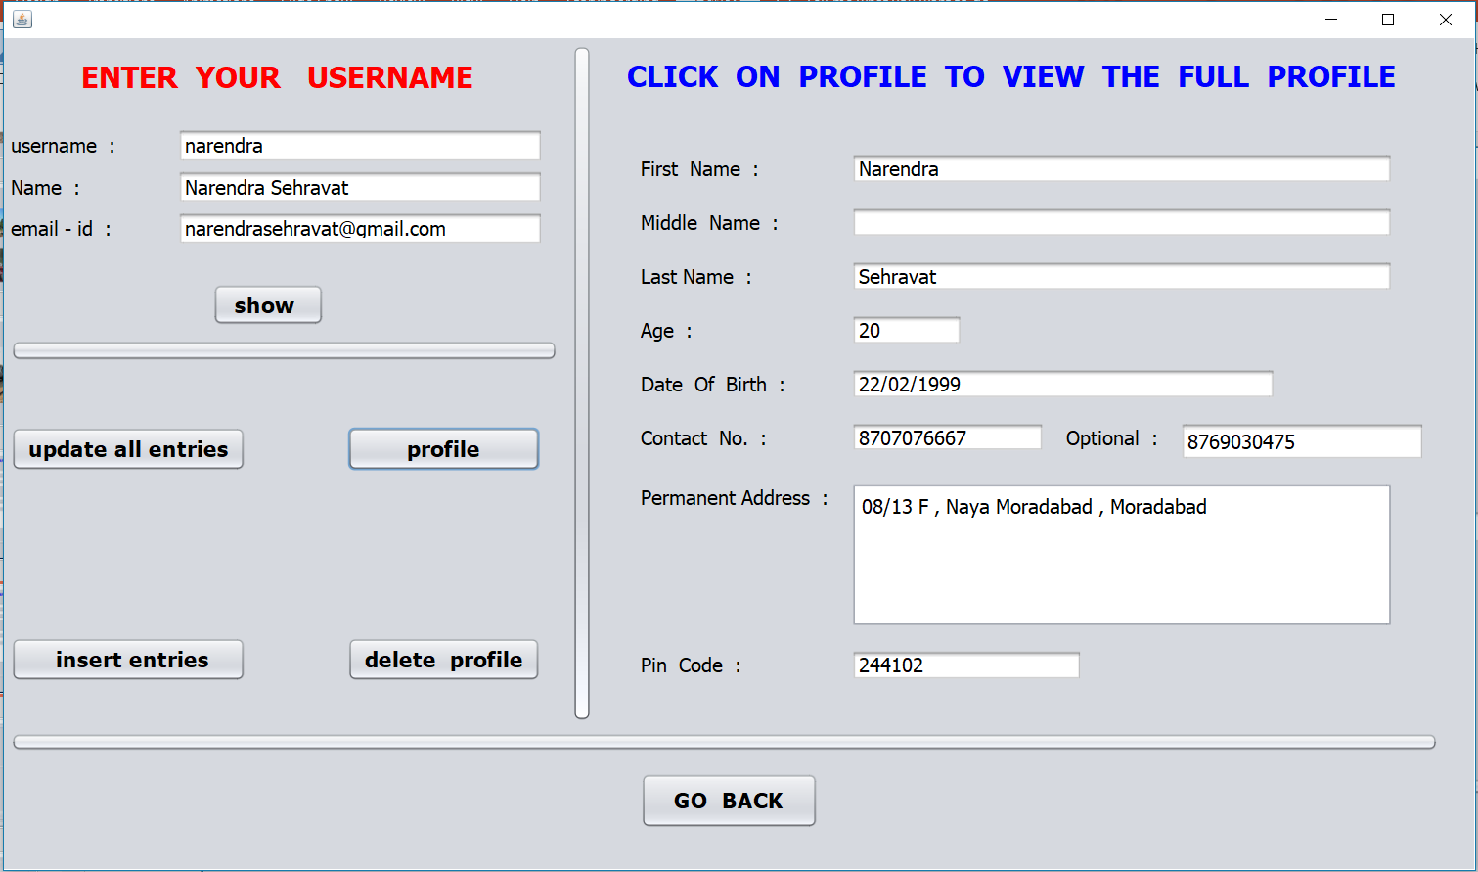

Slide 11
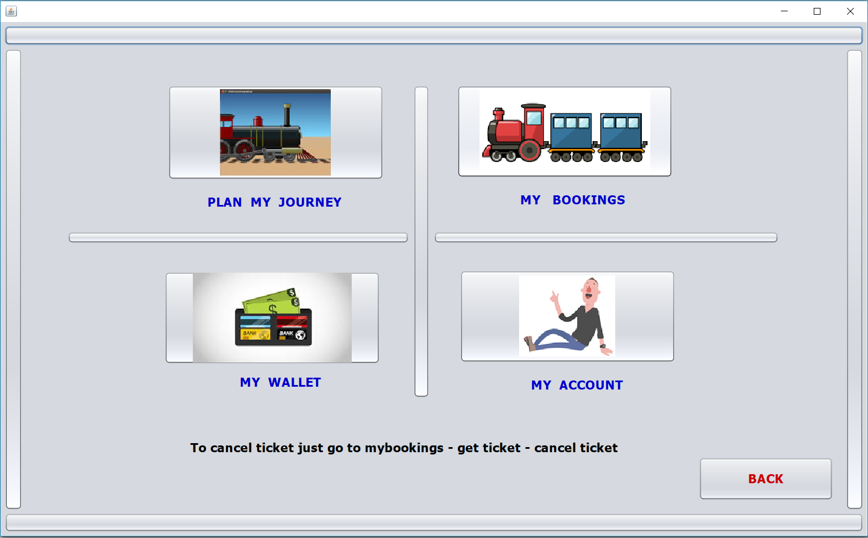

Slide 12
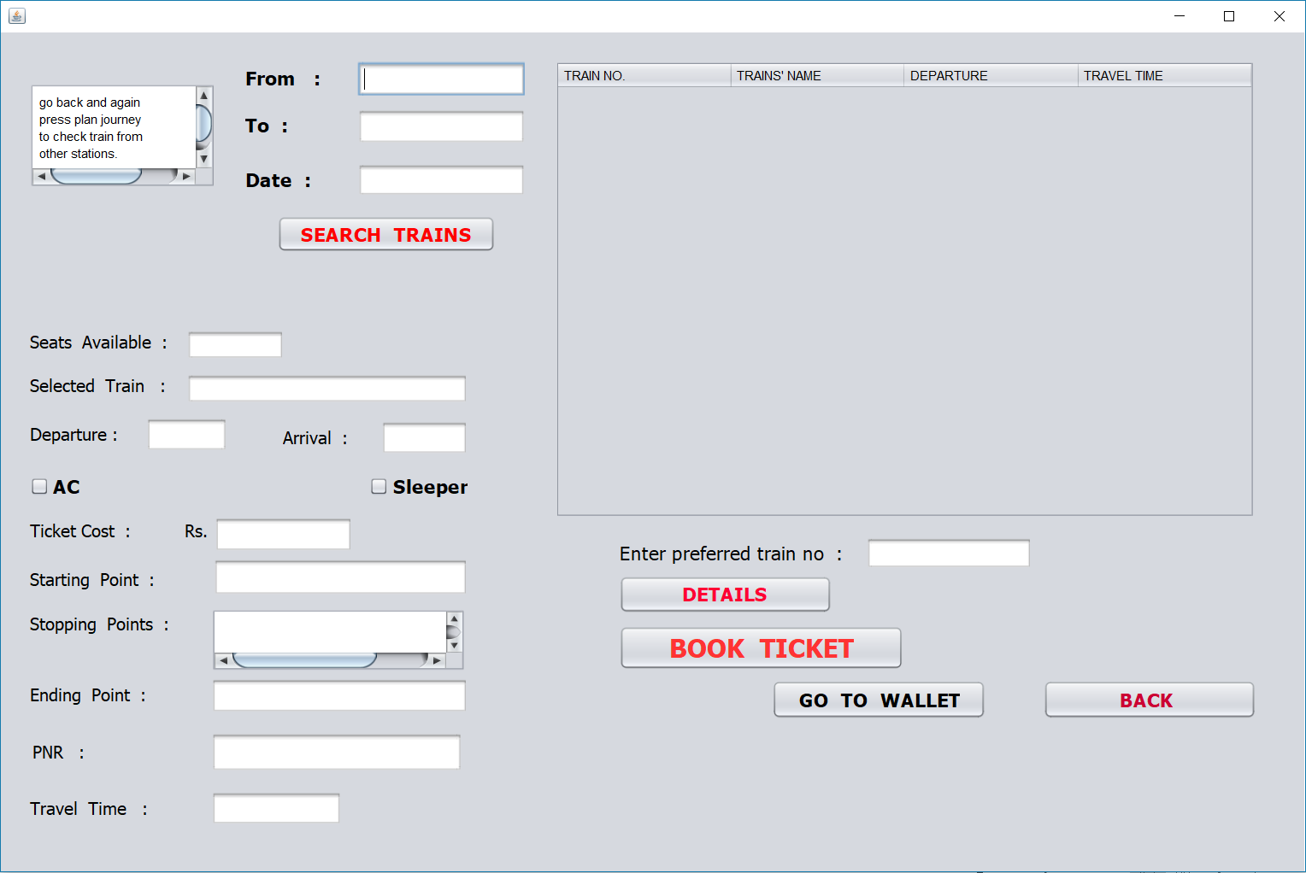

Slide 13
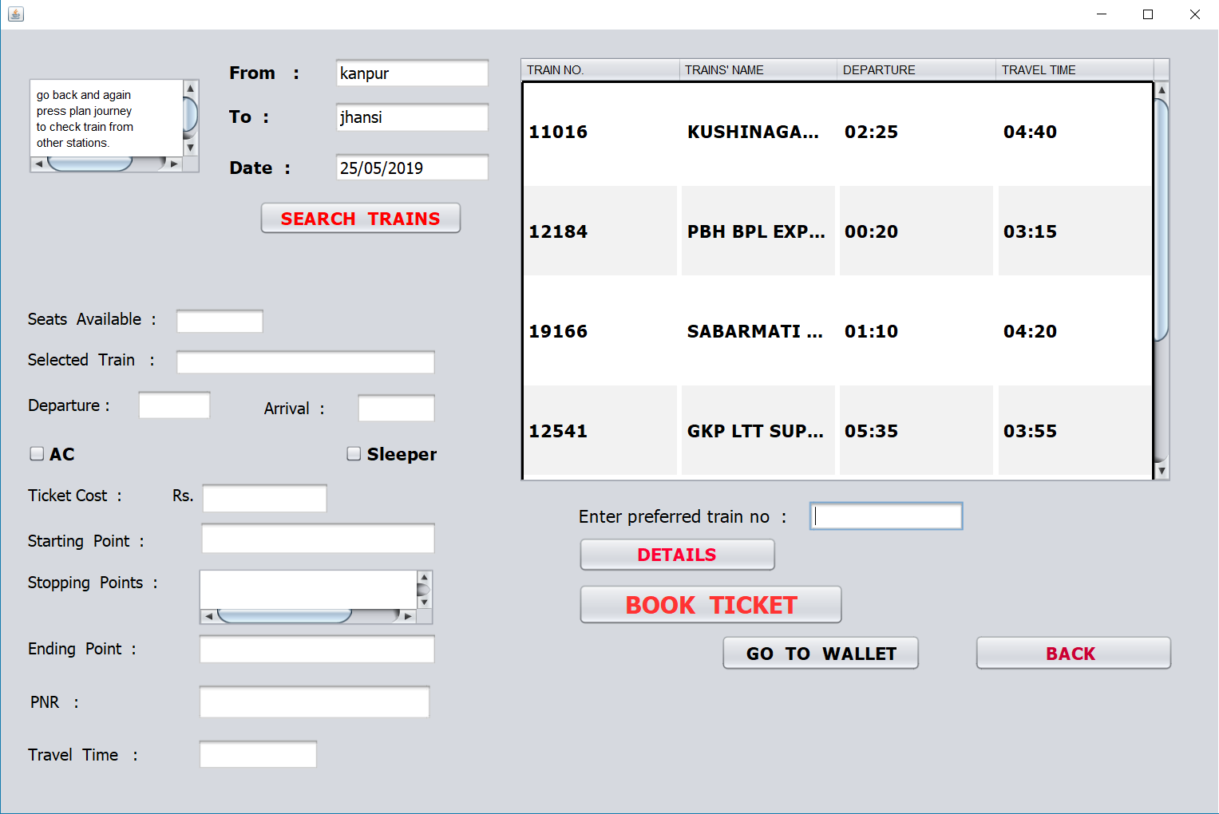

Slide 14
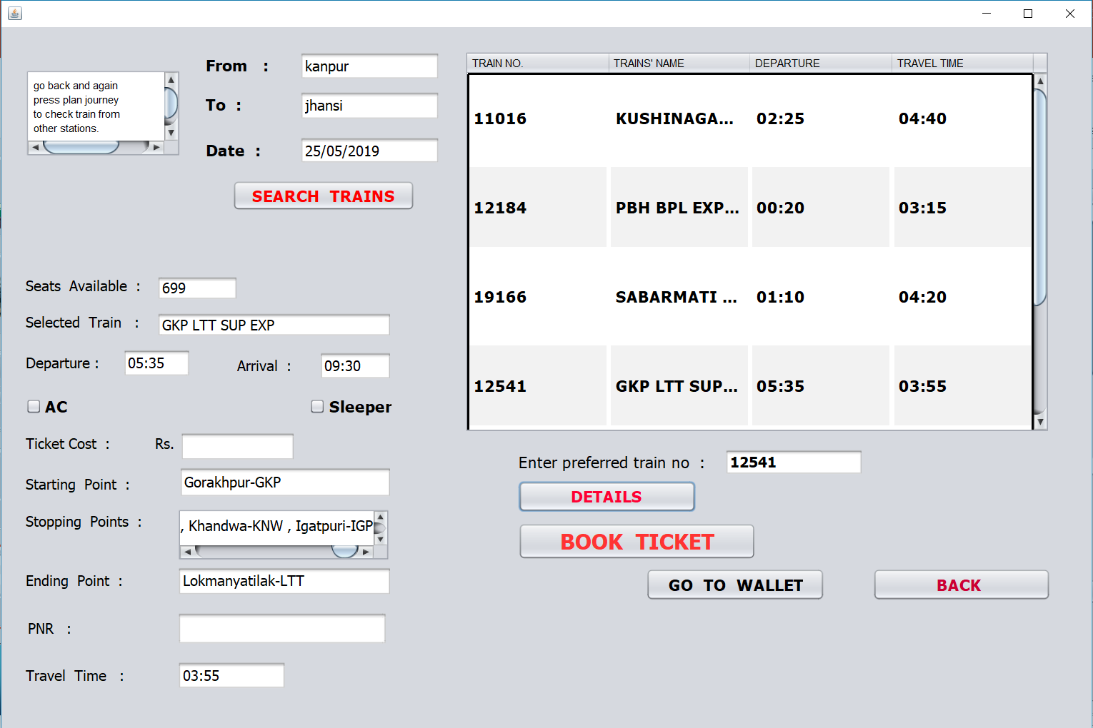

Slide 15
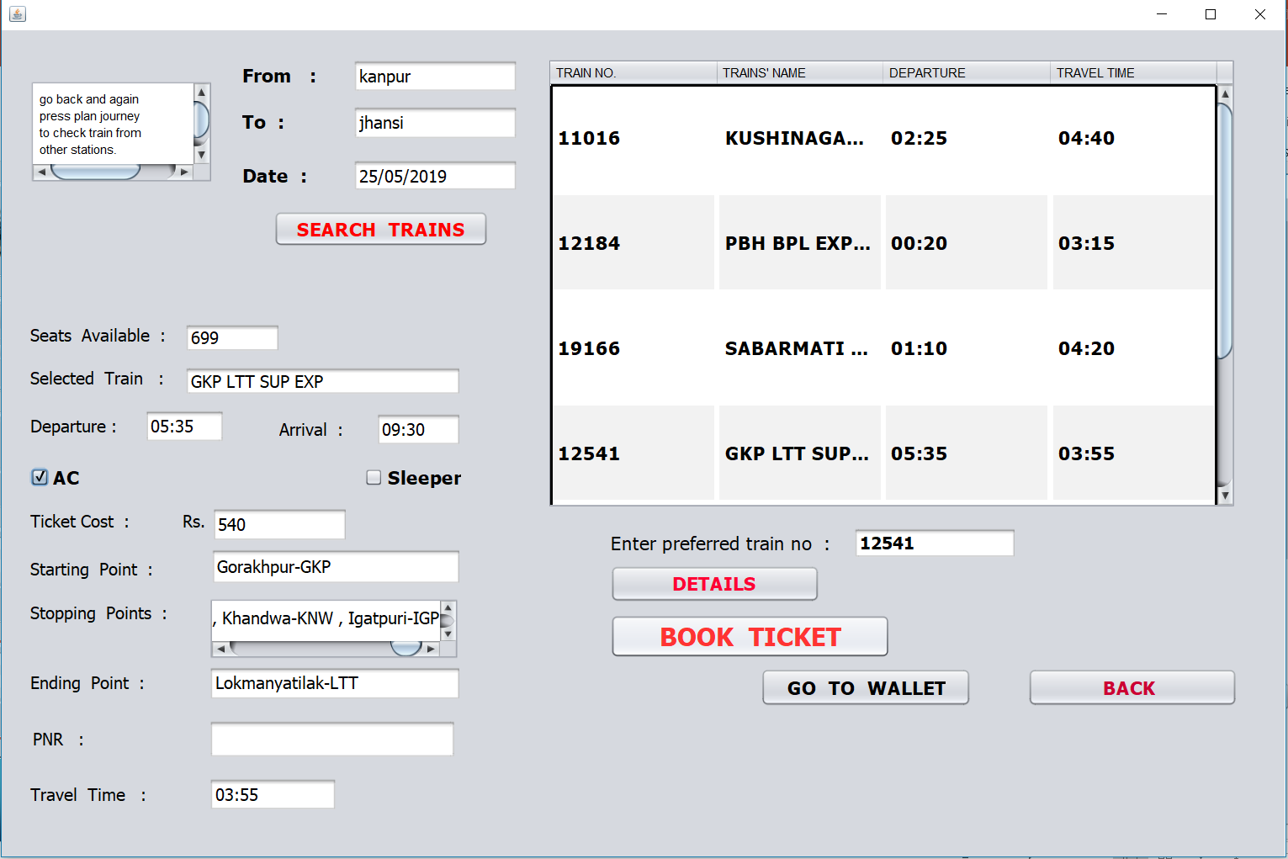

Slide 16
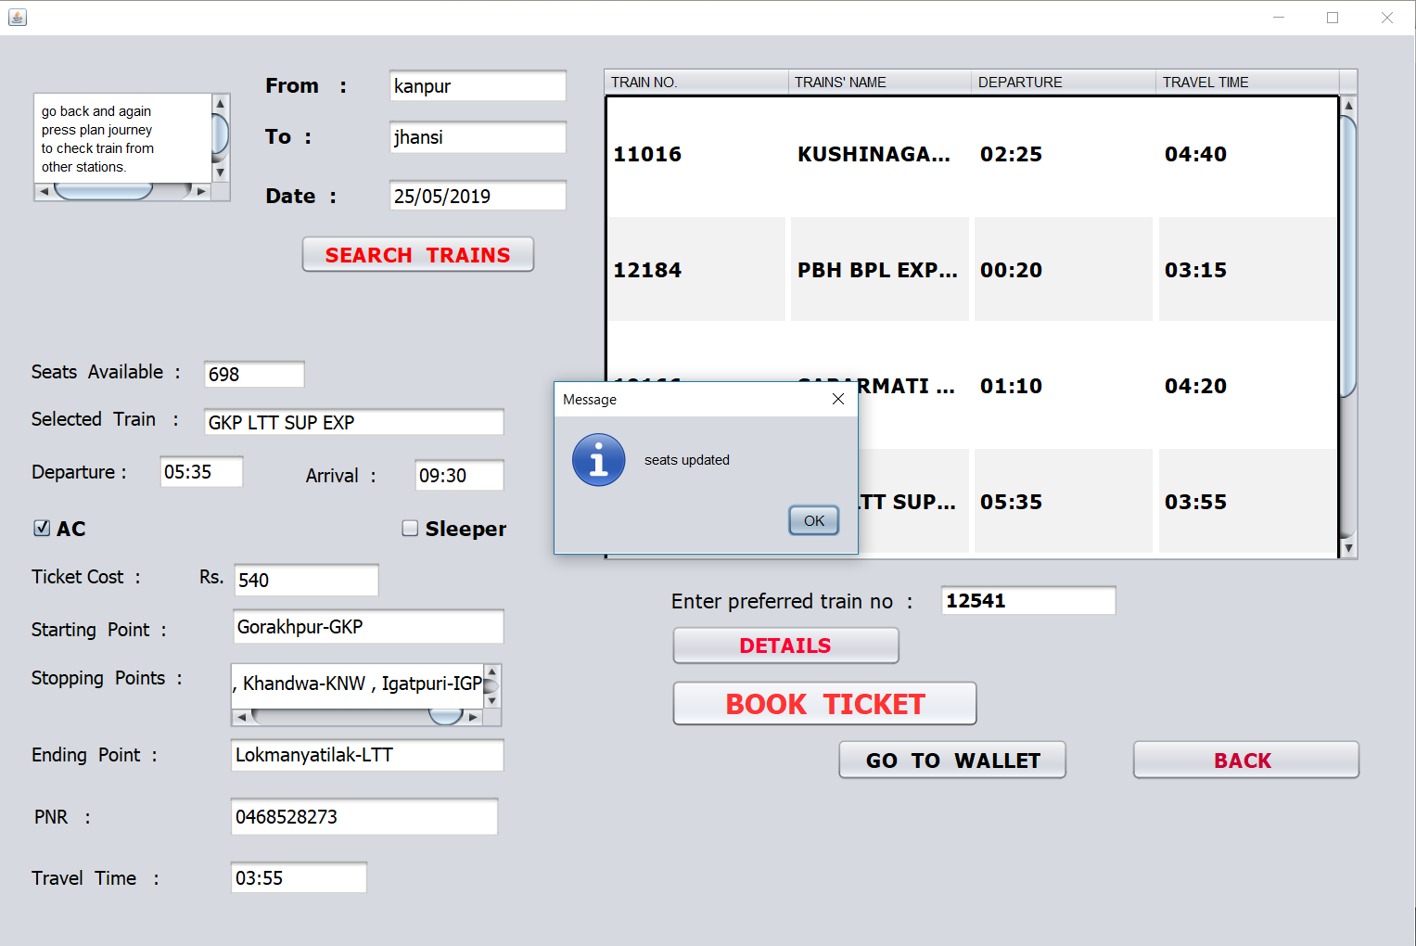

Slide 17


Slide 18
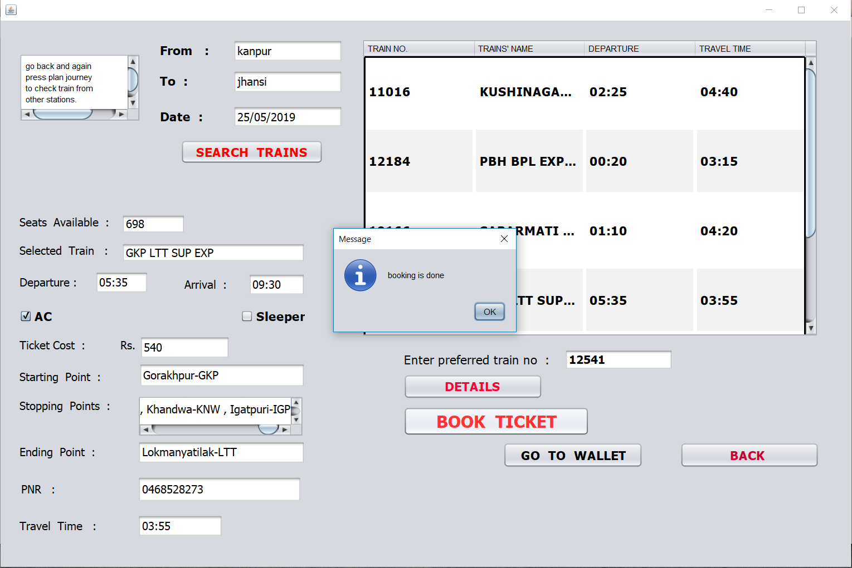

Slide 19
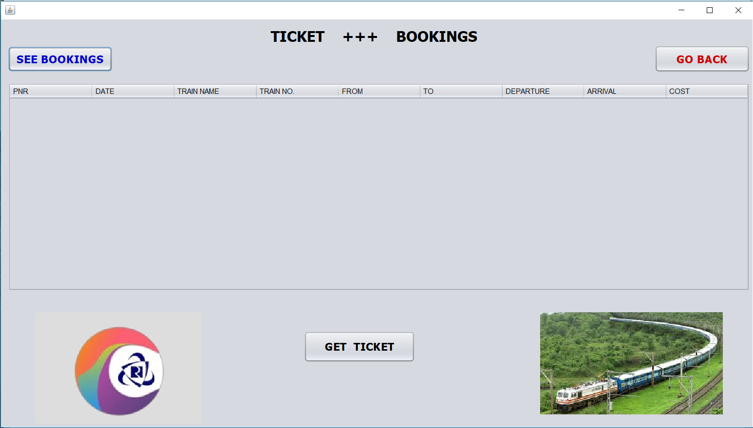

Slide 20
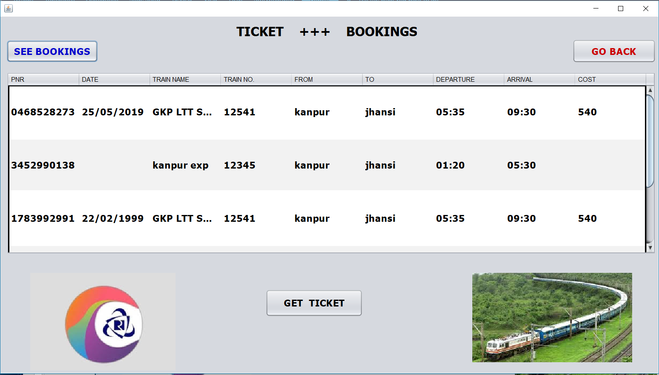

Slide 21
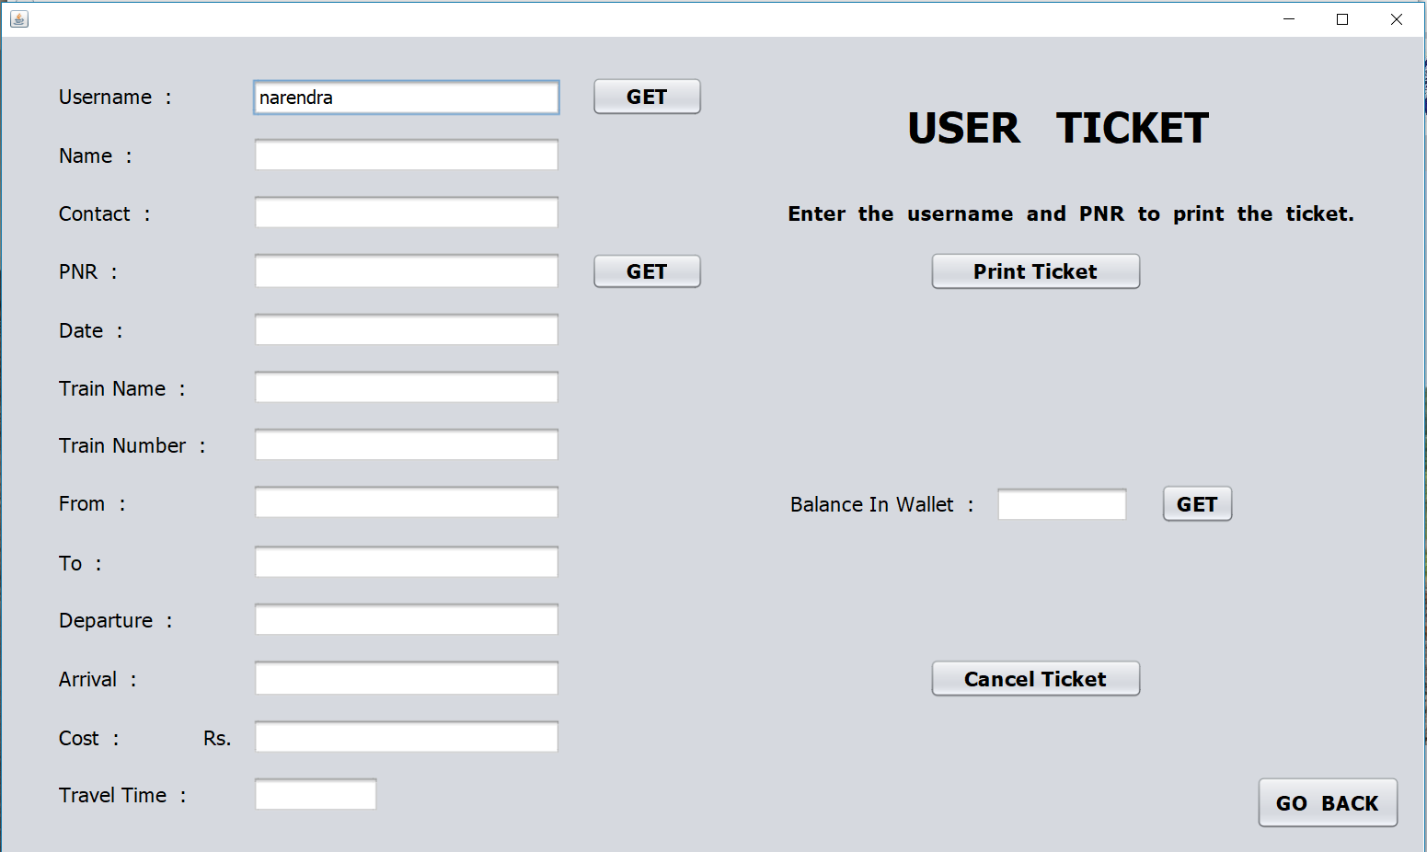

Slide 22
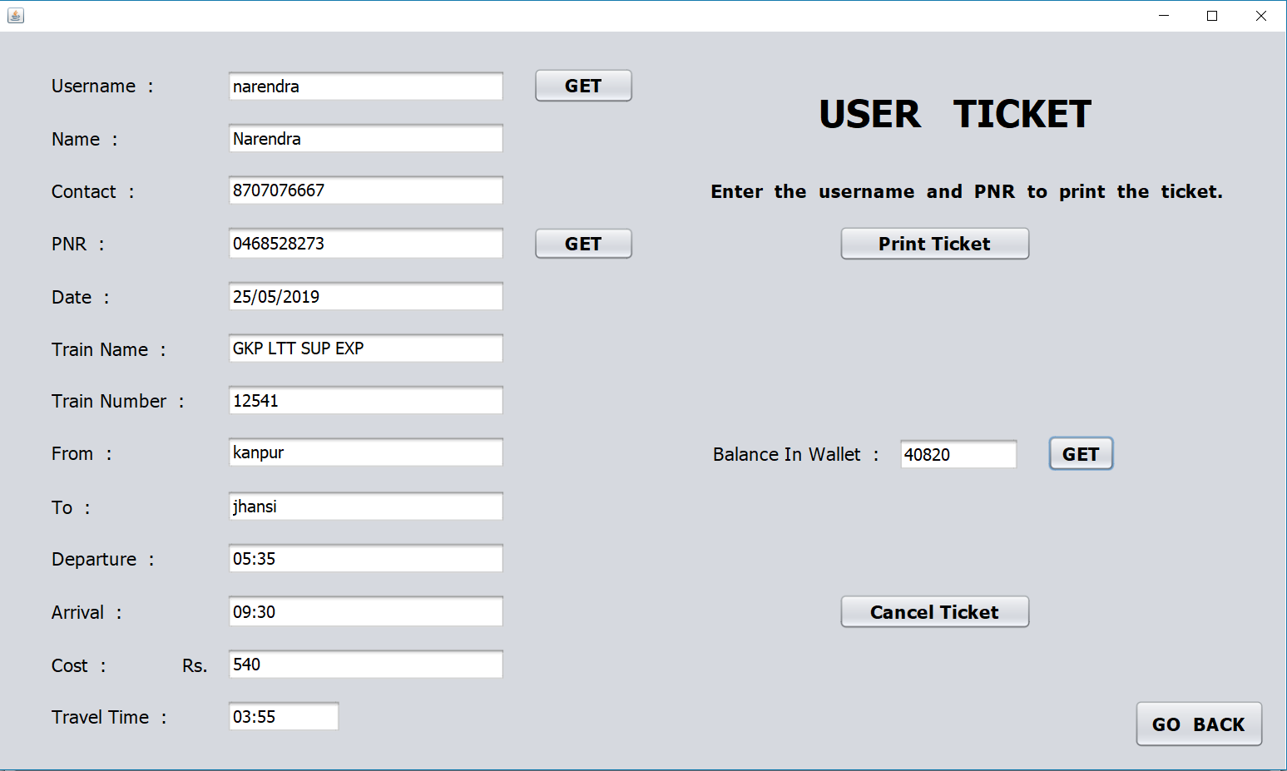

Slide 23
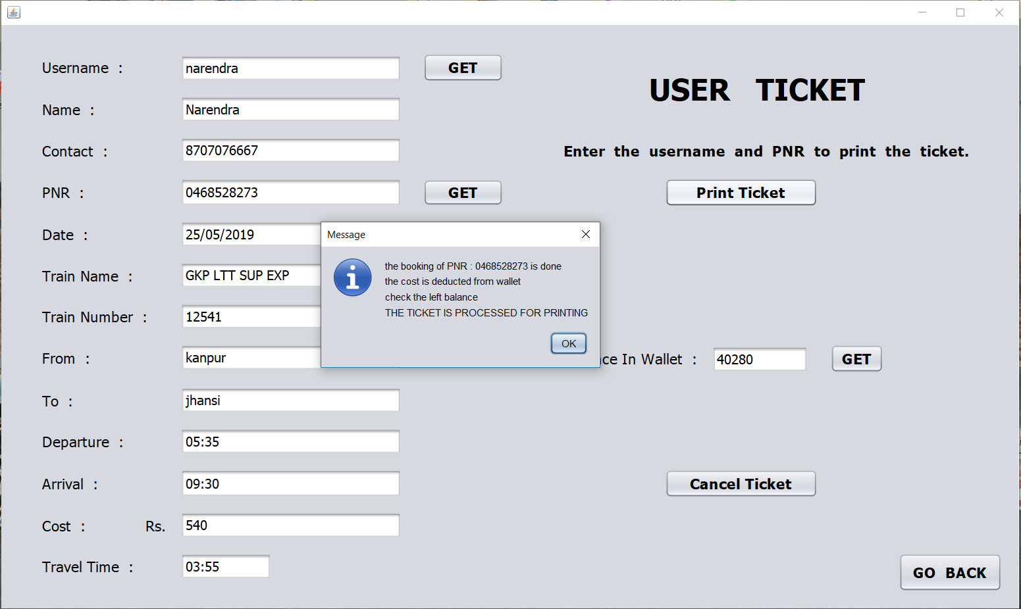

Slide 24
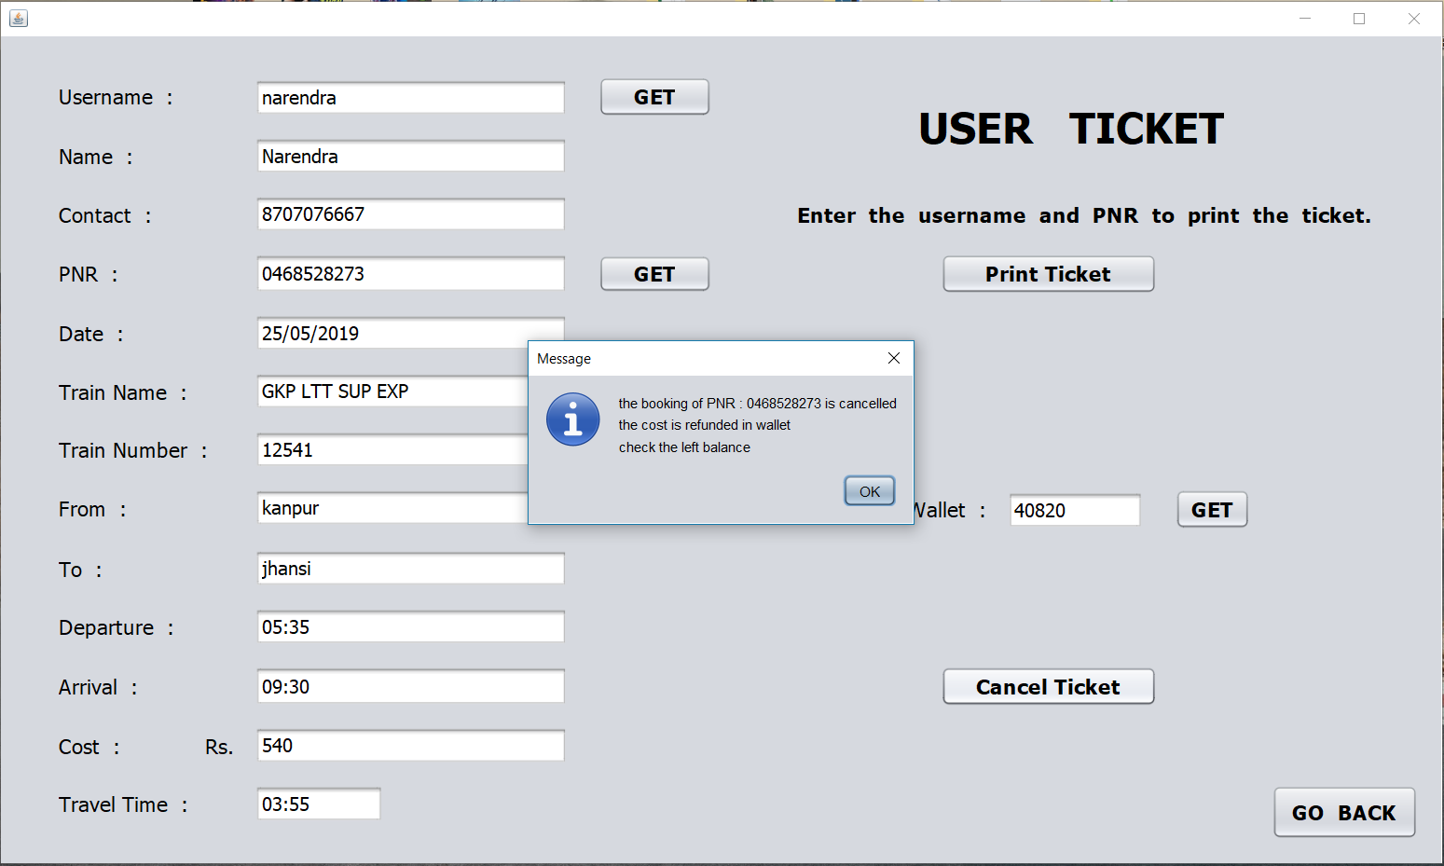

Slide 25
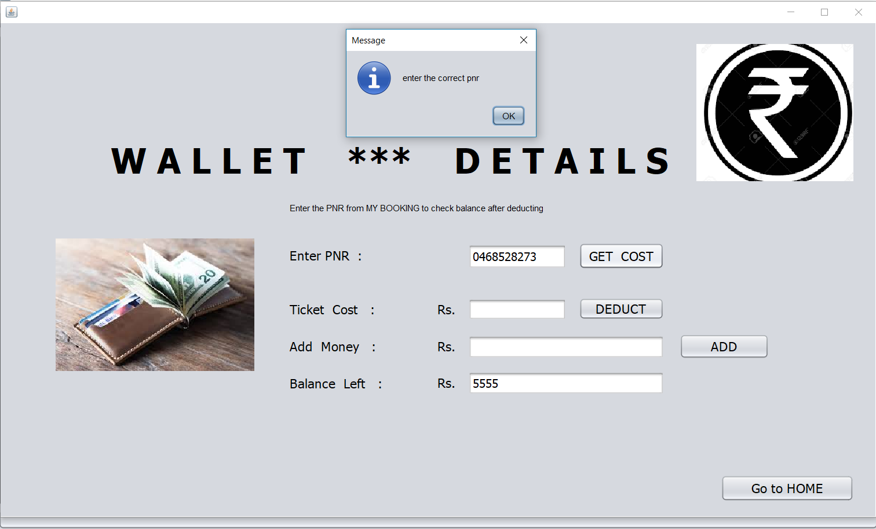

Slide 26
Thanking you

